Slide 1
Introduction
Hello and welcome. In this presentation I am share my insights for the company sales performance for the year 2011.

Slide 2
Thought process
I assure you that I have taken all the necessary steps to ensure the accuracy of this analysis.
I cleaned the provided data by removing negative values from the unit price and quantity columns and filtered the data as needed for all visualizations.

Slide 3
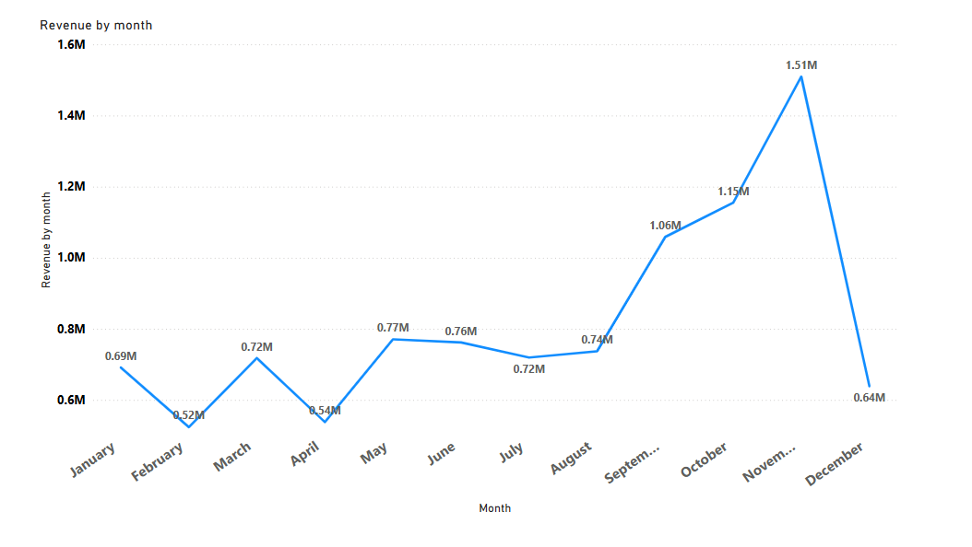
The first eight months had stable monthly revenues, averaging $685,000.
Starting in September, there was a significant increase in revenue, peaking at $1.5 million in November. From August to November, revenue grew by an average of 21.8%.
The revenue trends from August to December highlight the impact of seasonality on retail store sales.

Slide 4
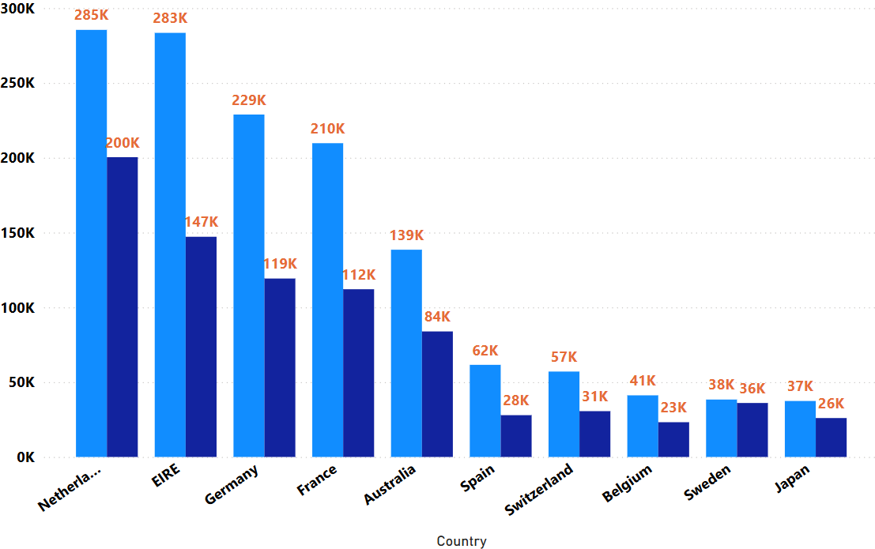
Top 10 Country revenue & their quantity
This chart highlights the top ten countries (excluding the UK) in terms of revenue generated and quantities sold.
The data reveals a strong correlation between revenue and quantity sold in these countries, indicating high purchasing power and a consistent demand for goods
These countries offer the greatest potential for revenue growth, and therefore, warrant focused marketing strategies from management to capitalize on their purchasing power and drive business expansion

Slide 5
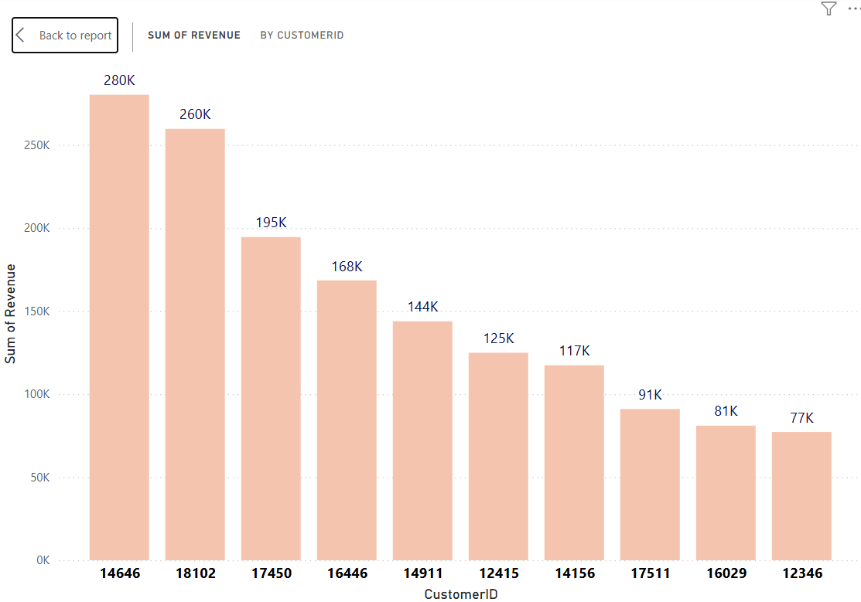
Top 10 costumers and Revenue
The chart reveals a relatively uniform revenue distribution among the top ten customers, with an average revenue difference of 15.8%.
This presents an opportunity for the company to nurture relationships with these high-value customers, fostering loyalty and retention, and ultimately driving increased sales and revenue.

Slide 6
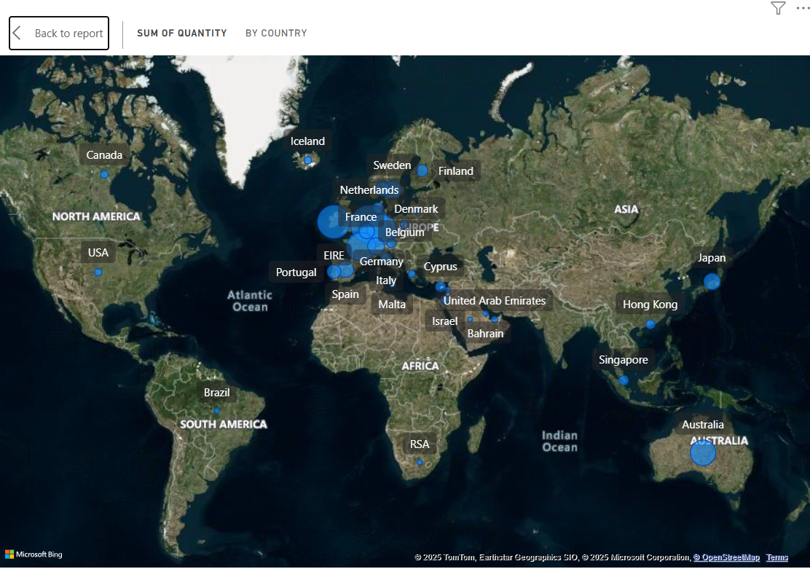
Revenue by Country
Notably, the data indicates that, aside from Russia, there is limited to no market demand for our items in Africa and Asia.
The map chart highlights a striking contrast between high-revenue regions and those with negligible sales, providing valuable insights for strategic market allocation.
The map reveals a significant concentration of sales within the European zone, with minimal presence in the American region. This suggests that the company should intensify its focus on the European market, exploring opportunities to maximize sales in each country, while also considering expansion into Australia and Japan.

Slide 7
Recommendations
To capitalize on fluctuating demand, the company should develop targeted strategies for stocking and advertising seasonal products, ensuring maximum sales during peak periods.
Fostering strong relationships with high-volume customers is crucial for enhancing retention rates and encouraging repeat business.
The European market presents significant opportunities for sales growth, and the company should prioritize developing tailored strategies to maximize sales potential in this region.

Slide 8
Thank You

